Slide 1
Three dimensional Knapsack problems
Phase 1.3, group 2

Slide 2
contents
Problem description
Possible solutions
Algorithm that we used
3D visualization (a and b)
Results for boxes
Results for pentominoes
Conclusions

Slide 3
Problem description
This project is about solving a three dimensional knapsack problem:
A cargo-space (with dimensions 16.5 x 2.5 x 4.0 ) has to be filled with parcels of different sizes and values in a way that the maximum value is reached
Boxes as parcels: A: 1.0 x 1.0 x 2.0; B: 1.0 x 1.5 x 2.0; C: 1.5 x 1.5 x 1.5
Pentominoes as parcels: each block of the letter being a square of 0.5
user friendly interface to decide on the variety and amount of different parcels
Questions:
a/c) is it possible to fill the complete cargo- space with the parcels?
b/d) what is the maximum value that you can store in your cargo-space if the parcels represent values of 3, 4 and 5 unites respectively?

Slide 4
Possible solutions
Backtracking algorithm as a solution for a)/c):
→ goes trough every possible combination of parcels to check if the space can be filled completely
Greedy algorithm as a solution for b)/d):
→ decides step by step what the highest value for the next few coordinates is and puts the parcel there if it fits
Dynamic programming as a solution for b)/d):
→ divides the problem into smaller tasks and solves them first in order to combine them recursively

Slide 5
Algorithm that we used: Greedy algorithm
Reason for our choice:
Easier than other algorithms
Fast
Sorting method 1: density
Sorting method 2: insertion sort

Slide 6
Pseudocode for the sorting method
INPUT: unsorted array
OUTPUT: new sorted array
FOR (each box in the array)
FOR (back to front)
IF (density of current box > density of next box)
switch the indexes of the boxes
RETURN the sorted array

Slide 7
Pseudocode for the solve method
FOR (each element in the array boxes)
FOR (the next x- coordiante which is still in the truck)
FOR (the next y- coordiante which is still in the truck)
FOR (the next z- coordiante which is still in the truck)
IF (box is still available)
FOR (the current rotation we check if it fits ){
IF (it fits in the empty space of the truck ){ place the box }
ELSE{ try next x- rotation
IF (each x- rotation tried, rotate once on y- axes)
IF (each y- rotation and all possible x- rotations tried, rotate once on z- axes); } }

Slide 9
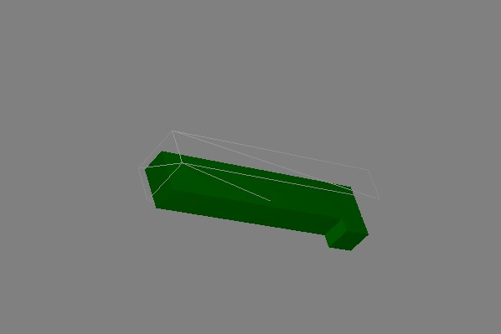
3D visualization

Slide 10
results for boxes: Can the cargo- Space be filled completely?
Not with only boxes of type A, B or C due to the size of these boxes:
Dimensions of boxes A: 1.0 x 1.0 x 2.0 cannot fill the width of 2.5 m
Dimensions of boxes B: 1.0 x 1.5 x 2.0 cannot fill the length of 16.5 m at the same time with filling out the 2.5 m width
Dimensions of box C: 1.5 x 1.5 x 1.5 cannot fill the height of 4.0 m

Slide 11
results for boxes: Can the cargo- Space be filled completely?
A and B
A and C
B and C
A, B and C

Slide 12
Results for Boxes: Maximum value of Cargo- space

Slide 13
results for pentominoes: Can the cargo- Space be filled completely?

Slide 14
results for pentominoes: Can the cargo- Space be filled completely?

Slide 15
Results for Pentominoes: Maximum value of Cargo- space

Slide 16
conclusions
Changing the order of the cargo- space changes the amount of boxes which fit in it
→ changes the total value of the content of the space

Slide 17
Group 2: wouter van elteren, kim roggenbuck, tobias mersch, hao yun

